Slide 1







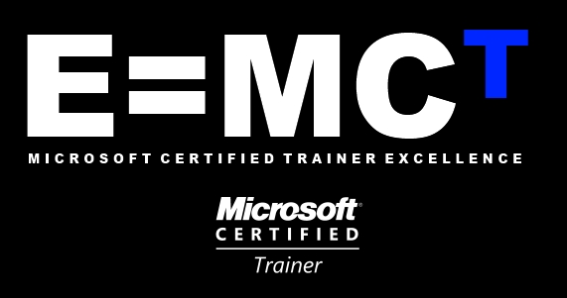

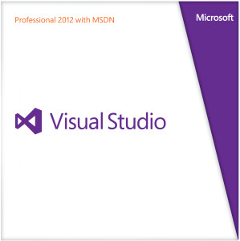




Slide 2
PMI POWERPOINT TEMPLATE
MAXIMUM 2 LINES, ARIAL 28PT BOLD
Application Foundation
Presented By :
Muhammad Atif Hussain
Head of I.T. (Takaful Pakistan Limited)
Technologies Consultant (AUC Technologies)
MCS(KU)
MSCS(SZABIST)
MCP
MCAD
MCSD
MCTS (Windows, Web, Distributed, SQL Server)
MCPD (Enterprise Applications)
MCT(Microsoft Certified Trainer)

Slide 3
Agenda
Framework
.NET Framework Introduction
.NET Framework Architecture
.NET Framework Versions
.NET Framework 4.5
Microsoft Visual Studio 2012
.NET Framework Technologies
.NET 4.5 and Visual Studio 2012 Certifications

Slide 4
Framework
Framework is a defined support structure in which another software project can be organized and developed
Framework are designed to meeting software requirement rather than providing the working system
Framework can be considered as the processes and technologies used to solve a complex issue
It is the skeleton upon which various objects are integrated for a given solution

Slide 5
.NET Framework Introduction
.NET Framework is a software component
It gives operating system features and responsibilities
It supports building and running the next generation of applications and XML Web services
It consists of Common Language Runtime and Base Class Library

Slide 6



.NET Framework Architecture
.NET Framework Architecture
VB
C#
C++
J#
Others
Common Language Specification
Web Service
User Interface
Visual Studio .NET
ADO.NET:Data and XML
.NET Framework Class Library
Base Class Library
Common Language Runtime (CLR)

Slide 7
Common Language Runtime
  CLR manages code execution at runtime
  Memory management, thread management, etc.
Common Language Runtime
Operating System

Slide 8
Base Class Library
  Object-oriented collection of reusable types
  Collections, I/O, Strings, …
.NET Framework (Base Class Library)
Common Language Runtime
Operating System

Slide 9
Data Access Layer
  Access relational databases
  Disconnected data model
  Work with XML
ADO .NET and XML
.NET Framework (Base Class Library)
Common Language Runtime
Operating System

Slide 10
Asp.NET & Windows Forms
  Create application’s front-end – Web-based user interface, Windows GUI, Web services, …
ASP .NET
Web Forms Web Services
Mobile Internet Toolkit
Windows
Forms
ADO .NET and XML
.NET Framework (Base Class Library)
Common Language Runtime
Operating System

Slide 11
Programming Languages
  Use your favorite language
C++
C#
VB
Perl
J#
…
ASP .NET
Web Forms Web Services
Mobile Internet Toolkit
Windows
Forms
ADO .NET and XML
.NET Framework (Base Class Library)
Common Language Runtime
Operating System

Slide 12
Common Language Specification
Common Language Specification
C++
C#
VB
Perl
J#
…
ASP .NET
Web Forms Web Services
Mobile Internet Toolkit
Windows
Forms
ADO .NET and XML
.NET Framework (Base Class Library)
Common Language Runtime
Operating System

Slide 13
Visual Studio .NET
C++
C#
VB
Perl
J#
…
Visual Studio .NET
Common Language Specification
ASP .NET
Web Forms Web Services
Mobile Internet Toolkit
Windows
Forms
ADO .NET and XML
.NET Framework (Base Class Library)
Common Language Runtime
Operating System

Slide 14



Standard Compliance
C# Language – Submitted to ECMA
C++
C#
VB
Perl
J#
…
Visual Studio .NET
Common Language Specification
Open Language
Specification
ASP .NET
Web Services Web Forms
Mobile Internet Toolkit
Windows
Forms
Web services –
XML, SOAP-based
ADO .NET and XML
.NET Framework (Base Class Library)
XML-based
data access
Common Language Runtime
Operating System
Notes:
Inside the .NET Framework
Standards Compliance
Microsoft .NET is built on standards. Both the Common Language Infrastructure, CLI and Visual C# have been submitted to the ECMA for approval and adoption. The data and Web services are built on XML and SOAP.
.NET Framework supports Web standards:
HTML- Hyper-Text Markup Language
XML - Extensible Markup Language, the universal format for structured documents and data on the Web.
WSDL- Web Services Description Language (WSDL)
SOAP - Simple Object Access Protocol, a simple, XML-based protocol for exchanging structured and type information on the Web. The protocol contains no application or transport semantics, which makes it highly modular and extensible. (SOAP currently still has no encryption support either)
XPATH - XML Path Language
XSLT - XSL Transformations (XSLT), is an XML-based language that enables you to transform one class of XML document to another.

Slide 15









A Look Back…
A Look Back….
SP1
3.5
3.0
.NET 1.0
.NET 1.1
.NET 2.0
.NET 4
.NET 4.5
2002
2003
2005-08
2008-10
2012
CLR 1.0
CLR 1.1
CLR 2.0
CLR 4
CLR 4.5

Slide 16







The .NET Framework 4.0
.NET Framework 4.5
WPF
Win Forms
DLR
ASP.NET
WCF
LINQ
And more!
Base Class Libraries
The CLR
JIT & NGEN
Garbage Collector
Security Model
Exception Handling
Loader & Binder

Slide 17
.NET Framework Components (Major)
Following are the major components of .NET Framework:
Common Language Specification (CLS)
.NET Framework Languages
.NET Framework Base Class Library (BCL - FCL)
Common Language Runtime (CLR)

Slide 18
Common Language Specification (CLS)
An Important goal of .NET Framework is to support multiple languages.
But all languages are not created equal so it is important to agree upon a common subset that all languages will support
The Common Language Specification is an agreement among languages.
The CLS defines the minimum standards that .NET languages must confirm.
Common Language Specification provides a series of basic rules that are required for language integration.
Notes:
Operation Badar

Slide 19
.NET Framework Languages
The .NET Framework is language neutral – an application written in VB.NET can access a application written in C# which also can access the application written in J# and so on.
Third parties are providing additional languages (over a dozen so far)
Following are few of them
APL | C++ | C# | COBOL | Pascal
VB | Eiffel | Smalltalk | SML | J#
JScript | Mercury | Oz | Perl | Python

Slide 20
.NET Framework Class Library
The .NET Framework Class Library provides a collection of useful and reusable classes that can be utilized across multiple languages
The classes provided by .NET Framework are object-oriented and fully extendable.
All of these classes are logically grouped in to “Namespaces”.

Slide 21
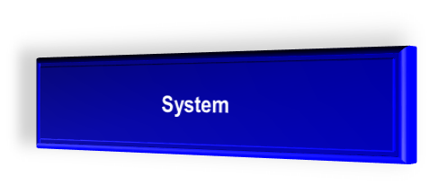
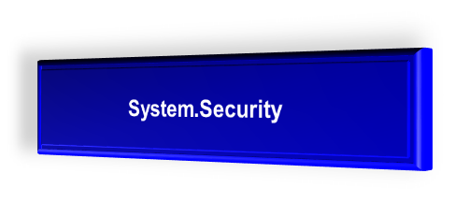
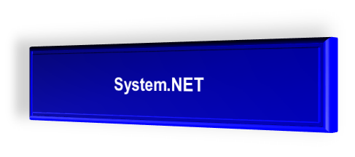
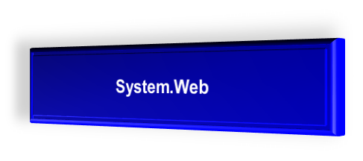
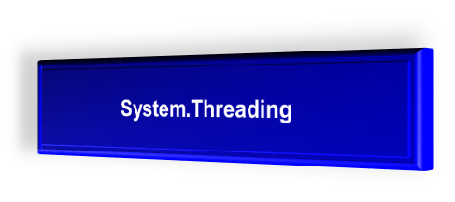
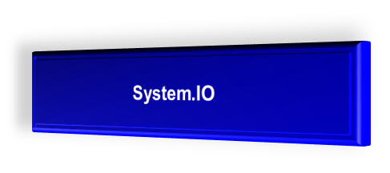
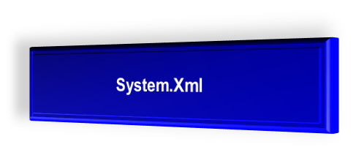
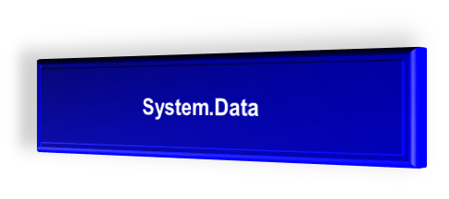
BCL/FCL Namespaces

Slide 22
Common Language Runtime (CLR)
CLR is the heart of .NET Framework. CLR manages execution of .NET code and provides useful services.
The basic function of CLR is to take the code generated by the C# compiler or any other compiler and converts it to the native language.
Traditionally there are different runtime for different programming environments.
Examples of runtimes include the standard C library, the Visual Basic runtime and Java Virtual Machine.

Slide 23
Common Type System (CTS)
.NET Framework also defines CTS which defines what types are allowed to run inside the framework.
The CTS provides a wide range of types and operations that are found in many programming languages.
The CTS provides a framework for cross-language integration.
Due to this there is no difference between Integer in VB.NET and int in C#, they are System.Int32 according to CTS.
VB.NET
System.Int32
C#
Integer
System.Int32
int
CTS Type

Slide 24
Common Type System (CTS)
CTS Type | Visual Basic.NET | C# | Visual C++.NET
Byte | Byte | byte | char
SByte | - | sbyte | signed char
Int16 | Short | short | short
Int32 | Integer | int | int ; long
Int64 | Long | long | _int64
Uint16 | - | ushort | unsigned short
Uint32 | - | uint | unsighed int; long
Uint64 | - | ulong | unsigned _int64
Single | Single | float | float
Double | Double | double | double
Object | Object | object | Object*
Char | Char | char | _wchar_t
String | String | string | String*
Decimal | Decimal | decimal | Decimal
Boolean | Boolean | bool | bool

Slide 25
Microsoft Intermediate Language (MSIL)
When a .NET application is compiled it is converted from the language it was written in (VB.NET, C#, J# etc) to a Managed Module.
This Managed Module contain MSIL which is direct compiled form of your code and metadata.
MSIL is a low level set of instructions understood by Common Language Runtime.

Slide 26
Compiling Source into Managed Module
C#
Source Code
VB.NET
Source Code
J#
Source Code
C#
Compiler
VB.NET
Compiler
J#
Compiler
Managed Module
MSIL and metadata
Managed Module
MSIL and metadata
Managed Module
MSIL and metadata

Slide 27
Structure of Managed Module
Metadata
MSIL
Type 1
Fields
Properties
Methods
Events
Type 2
Fields
Properties
Methods
Events

Slide 28
Metadata / Manifest data
Every managed module contains metadata that describe the two things:
1. The types (classes) and members defined in your source code.
2. The types (classes) and members referenced by your source code.
Metadata is always associated with the file that contain the IL code.

Slide 29
Just in Time Compiler (JIT)
Before executing on the target machine, MSIL is translated by just-in-time (JIT) compiler to native code.
Some code typically will never be executed during a program run.
Hence it may be more efficient to translate MSIL as needed during execution, storing the native code for reuse.

Slide 30
.NET Assembly
The primary unit of a .NET application is the assembly. An assembly is a self describing collections of one or more managed modules and resource files.
An assembly is the smallest unit of reuse, security and versioning.
Assembly manifest provides information about what is contained within the assembly.

Slide 31
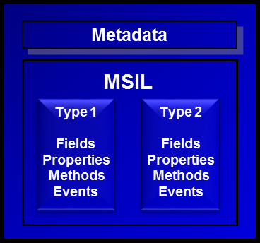
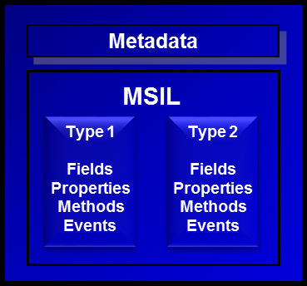




Structure of .NET Assembly
Resource Files
.html, .gif etc
Resource Files
.html, .gif etc
manifest
Resource Files
.html, .gif etc
Resource Files
.html, .gif etc

Slide 32
Compilation and Execution of .NET Assembly
When you compile a .NET application it is converted into managed module or MSIL (.exe or .dll)
The assembly contain at lease one .exe file that has been designated as the entry point for the application.
When execution of your program begins, the assembly is loaded into memory.
At this time the CLR examines the assembly manifest and determines the requirements to run the program.
It examines security permissions requested by the assembly and compares them to the system’s security policy.
If the system’s security policy does not allow the requested permissions, the application will not run
If the application passes the system’s security policy, the CLR executes the code.

Slide 33
Continue..
When execution starts, the Just-In-Time (JIT) compiler of CLR compiles the IL code into native code and now native code is loaded in memory to execute.
C#
Run
Compile
MSIL
JIT Compiler
JIT
Native
Code

Slide 34
.NET Framework Versions
.NET Framework 1.0 5th January 2002
.NET Framework 1.1 1st April 2003
.NET Framework 2.0 7th November 2005
.NET Framework 3.0 6th November 2006
.NET Framework 3.5 27th February 2008
.NET Framework 4.0 12th April 2010
.NET Framework 4.5 15th August 2012

Slide 35
Microsoft Visual Studio .NET
Development tool that contains a rich set of productivity and debugging features
  Supports managed and unmanaged applications
  Supports C#, C++, VB.NET, …
  Many useful tools and wizards
  Windows Forms Designer
  ASP.NET Web Forms Designer
  Web Services support
  SQL Server integration with ADO.NET and XML
VS.NET is not part of the .NET Framework
  Not necessary to build or run managed code
  The .NET Framework SDK includes command line compilers

Slide 36
VS.NET – Single Development Environment
From Visual Studio.NET you can:
  Write code
  Design user interface
  Study documentation
  Debug
  Test
  Deploy
Same tools for all languages
Same tools for all platforms

Slide 37
Microsoft Visual Studio Versions
Visual Studio 97 1997
Visual Studio 6.0 1998
Visual Studio .NET (2002) 2002
Visual Studio .NET (2003) 2003
Visual Studio .NET (2005) October 2005
Visual Studio .NET (2008) November 2007
Visual Studio .NET (2010) 12th April, 2010
Visual Studio .NET (2012) 15th August, 2010

Slide 38
.NET Certifications
MCSD - Windows Store Apps
  Programming in C# [Exam 70-483]
  Essentials of Developing Windows Store Apps Using C# [Exam 70-484]
  Advanced Windows Store App Development Using C# [Exam 70-485]
MCSD – Web Applications
  Programming in HTML5 with JavaScript and CSS3 [Exam 70-480]
  Developing ASP.NET MVC 4 Web Applications [Exam 70-486]
  Developing Windows Azure and Web Services [Exam 70-487]
MCSD – Application Lifecycle Management
  Administering Microsoft Visual Studio Team Foundation Server 2012 [Exam 70-496]
  Software Testing with Visual Studio 2012 [Exam 70-497]
  Delivering Continuous Value with Visual Studio 2012 Application Lifecycle Management [Exam 70-498]

Slide 39
Questions
?

